Slide 1
Personas
In Design Thinking
Lecture
Professor Heike Winschiers-Theophilus
12 May 2020

Slide 2
Content
Persona definition
Purpose of Persona
Persona Description
How to create a persona
Own Examples of persona creations and use
https://www.interaction-design.org/literature/article/personas-why-and-how-you-should-use-them

Slide 3
Persona definitions
“Personas are not real people, but they represent them throughout the design process. They are hypothetical archetypes of actual users. […] Personas are defined by their goals.” Alan Cooper
“Personas are fictional characters, which you create based upon your research in order to represent the different user types that might use your service, product, site, or brand in a similar way. “Interaction Design Foundation

Slide 4
Purpose of Personas
“Creating personas will help you
to understand your users’ needs, experiences, behaviours and goals…
step out of yourself.
to recognise that different people have different needs and expectations
to identify with the user you’re designing for
make the design task at hand less complex,
guide your ideation processes
to achieve the goal of creating a good user experience for your target user group.”
https://www.interaction-design.org/literature/article/personas-why-and-how-you-should-use-them

Slide 5
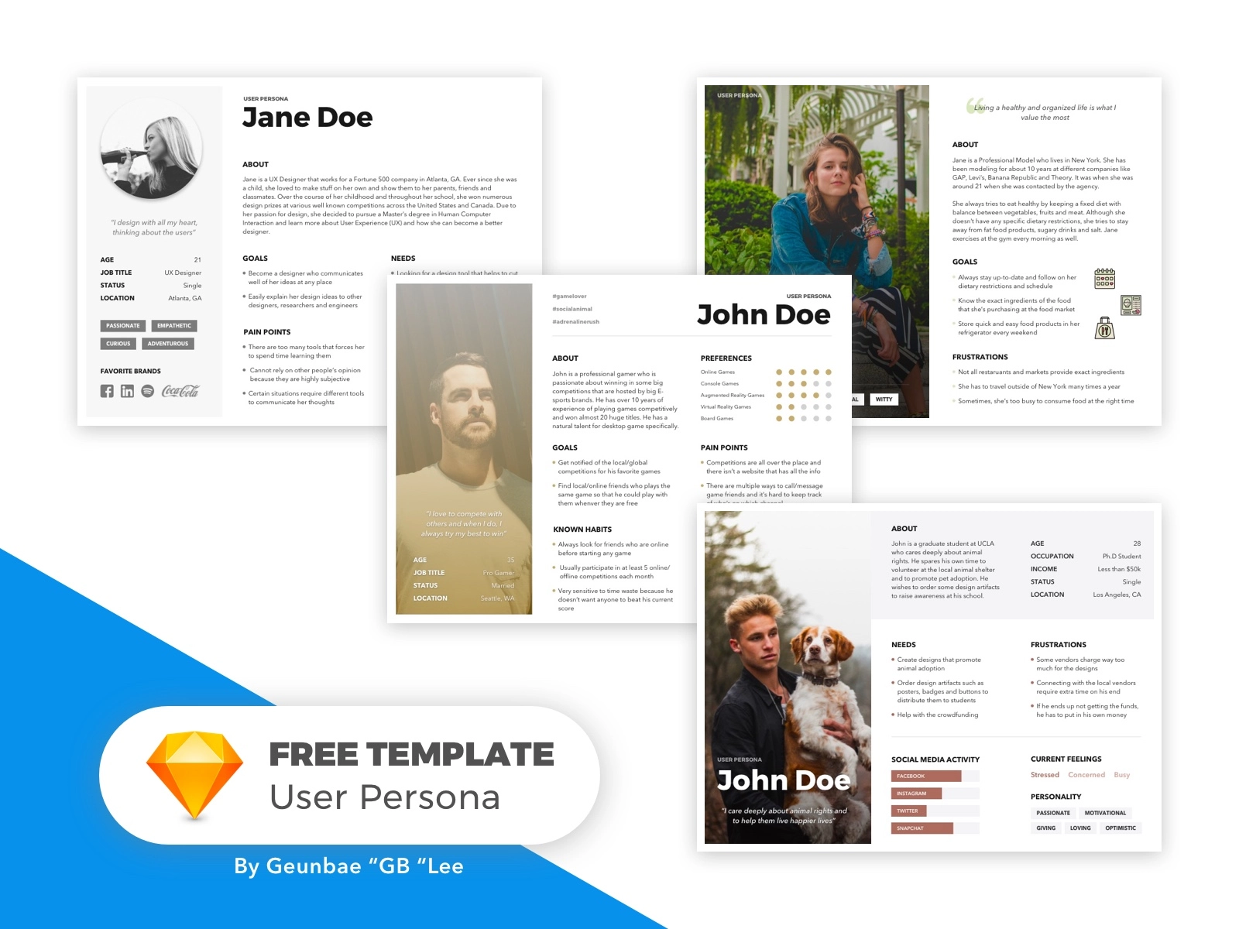
Persona descriptions
https://dribbble.com/shots/4212167--Free-Template-User-Persona-Bundle

Slide 6
How to create personas
Designer created
  Quantitative user studies
  Qualitative user studies
  Social listening
  Analytics
  Invent them
  Team effort
User created
  Brainstorming
  Collages
  Storytelling

Slide 7
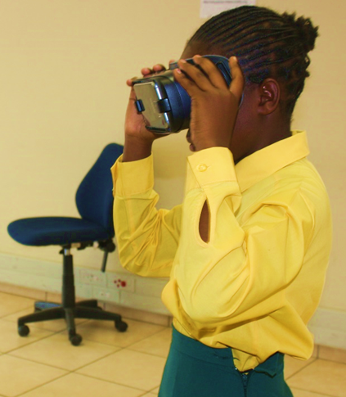
Co-designing with children
Children cannot “replace” experienced designers
but
“children are experts at being children” (Fails, Guha, Druin, 2013)
Can children anticipate the future?
Can children design for collective spaces
and other children?
Fails, JA, Guha, ML and Druin A. "Methods and techniques for involving children in the design of new technology for children." Foundations and Trends in Human–Computer Interaction 6.2 (2013): 85-166.
Notes:
Can children envision the future?

Slide 8
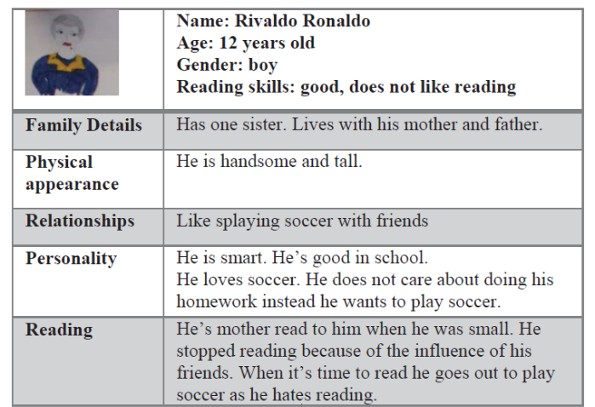
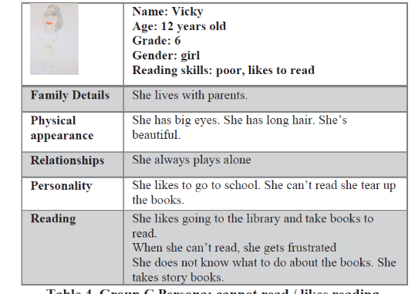
Child-created Child personas
Helvi Itenge-Wheeler, Heike Winschiers-Theophilus, Alessandro Soro, Margot Brereton, (2018), Child designers creating personas to diversify design perspectives and concepts for their own technology enhanced library, in Proceedings of the 17th ACM Conference on Interaction Design and Children, 381-388

Slide 9
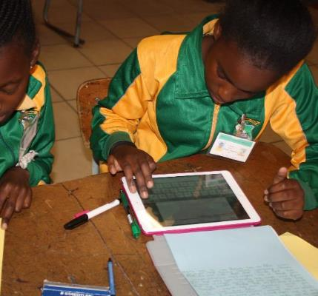
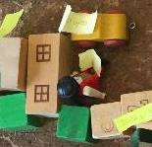
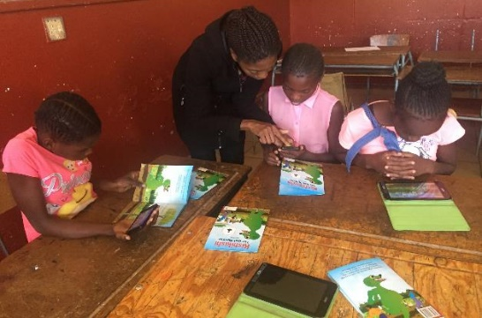

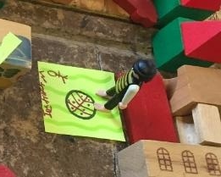
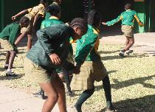
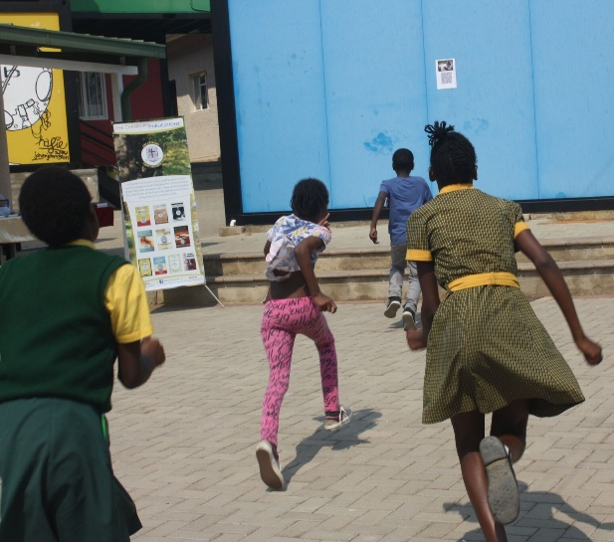


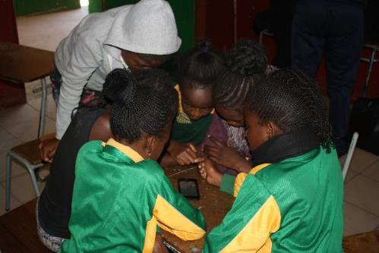
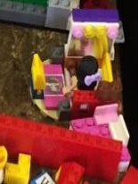
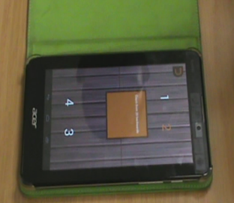
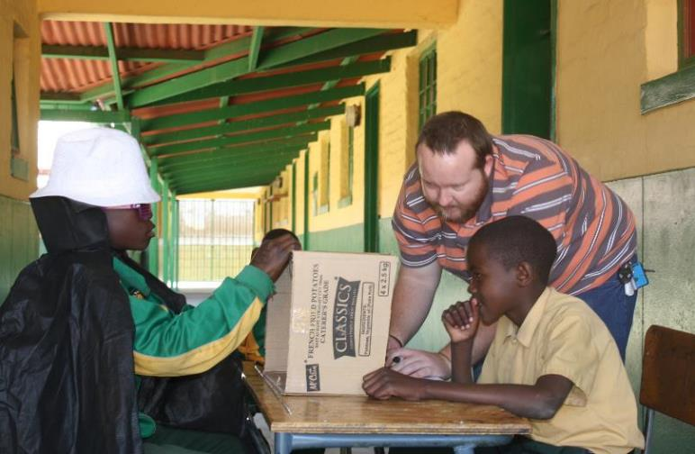
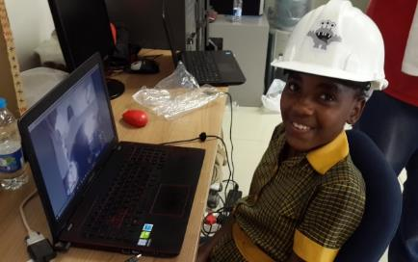


Real children designing with fictitious children
Anna Michel
Ronaldo
Vicky
Stella
Helvi Itenge-Wheeler, Heike Winschiers-Theophilus, Alessandro Soro, Margot Brereton, (2018), Child designers creating personas to diversify design perspectives and concepts for their own technology enhanced library, in Proceedings of the 17th ACM Conference on Interaction Design and Children, 381-388

Slide 10
Co-designing with children
Findings
→Children can design for other children
Children created Child Personas is a suitable method to create empathy and novel designs
Children can directly contribute to technology innovation
Helvi Itenge-Wheeler, Heike Winschiers-Theophilus, Alessandro Soro, Margot Brereton, (2018), Child designers creating personas to diversify design perspectives and concepts for their own technology enhanced library, in Proceedings of the 17th ACM Conference on Interaction Design and Children, 381-388

Slide 11
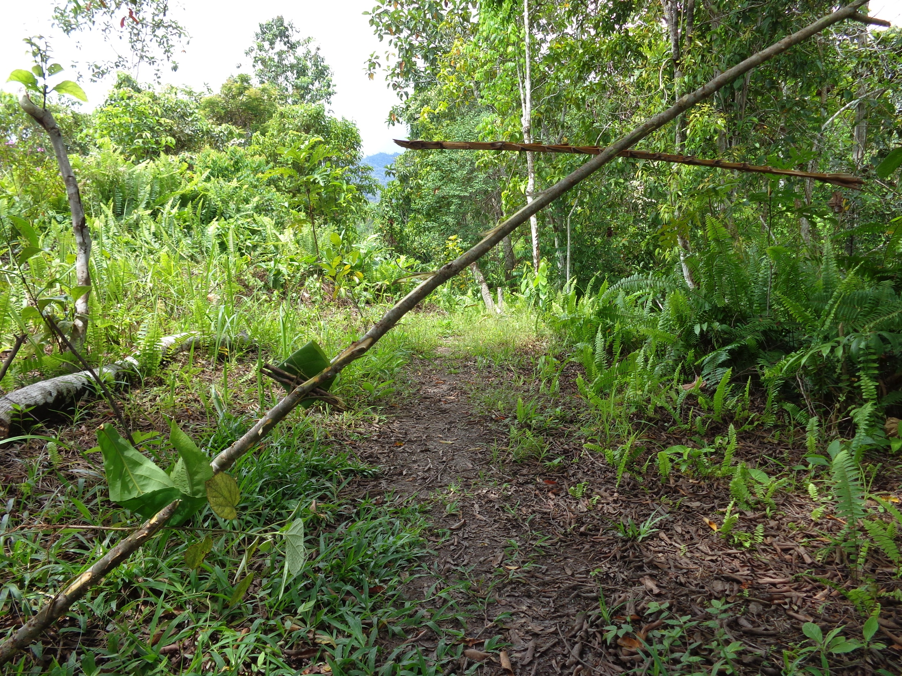
Co-design of secret language app
We are from the same group. I’m alone, very very hungry and I have only water to survive. I am going to the river in this direction. Follow me and if you have anything to eat please bring along.…

Slide 12
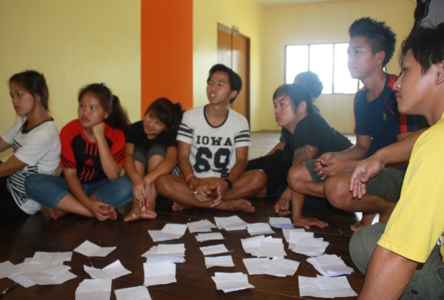
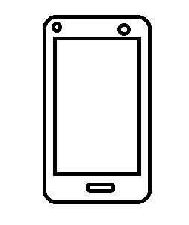
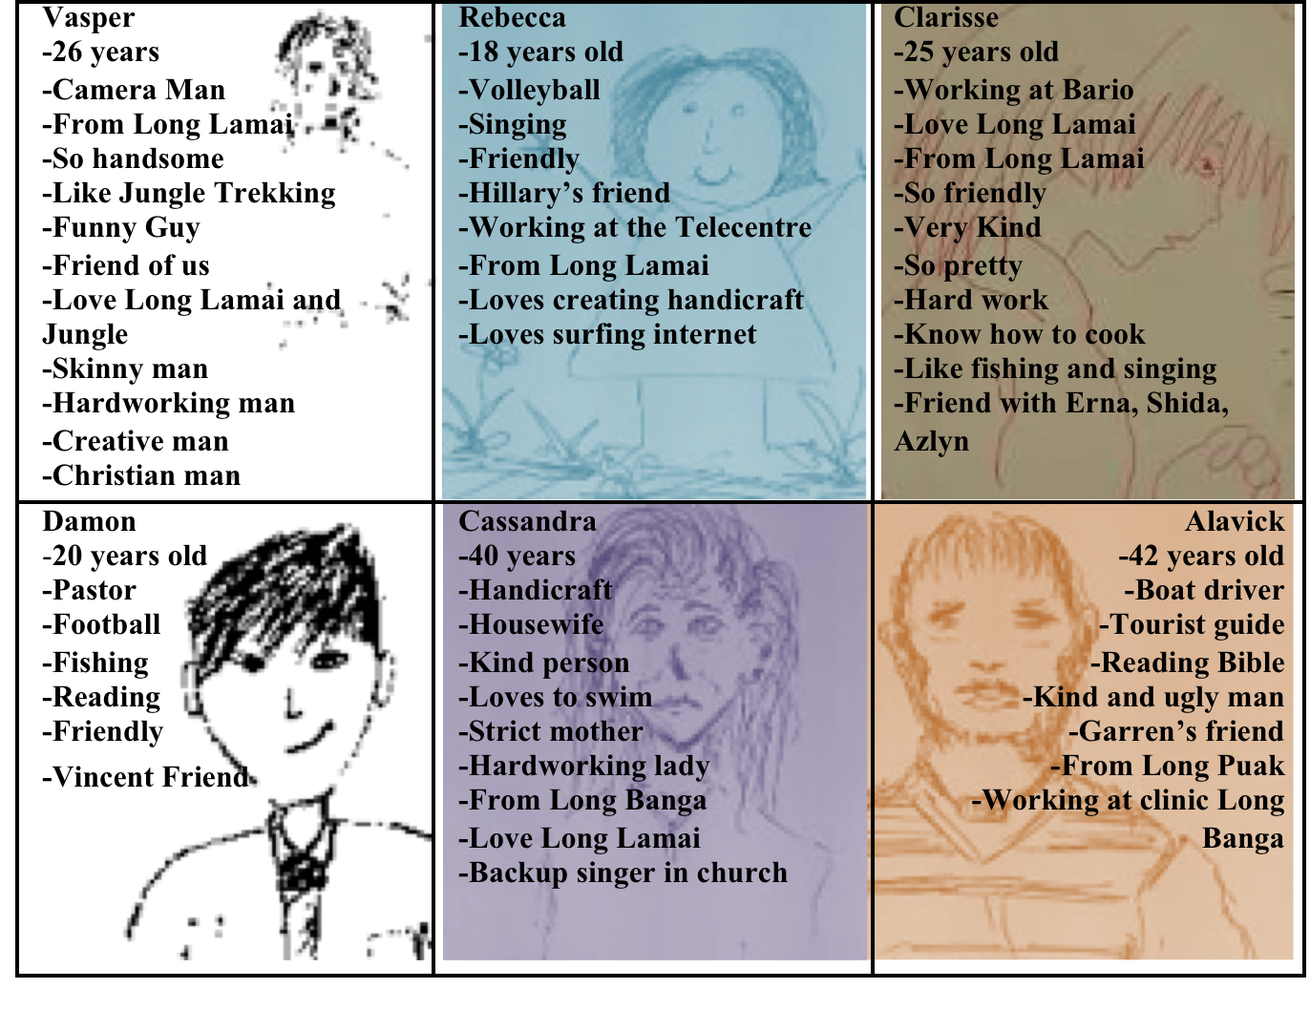
Design of Personas
Use of Personas
to create messages
Penan’s Oroo’Short Message Signs (PO-SMS): co-design of a digital jungle sign language application,
T Zaman, H Winschiers-Theophilus, IFIP Conference on Human-Computer Interaction, 489-504, 2015

Slide 13
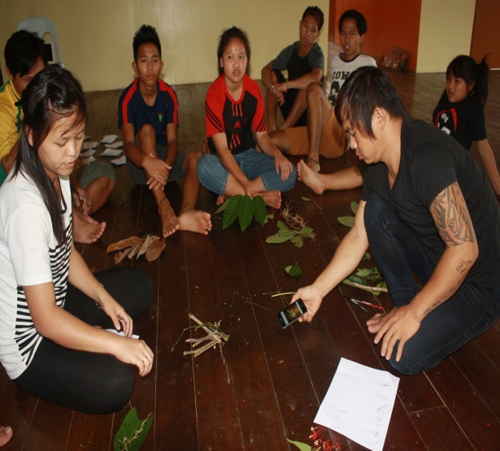
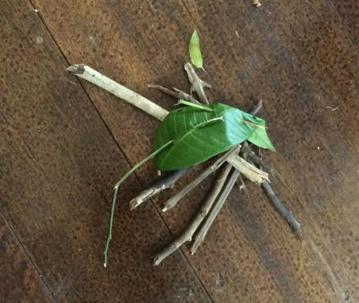
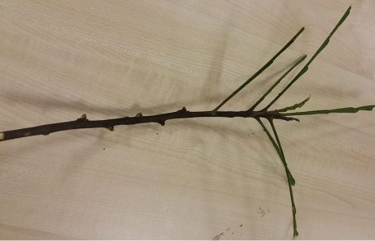
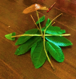
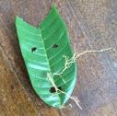
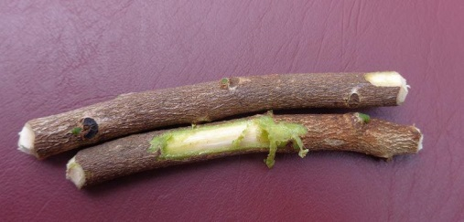
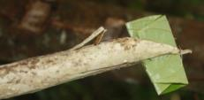

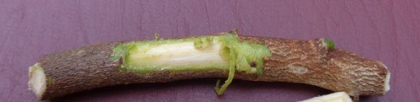
Creation of new Signs
Penan’s Oroo’Short Message Signs (PO-SMS): co-design of a digital jungle sign language application,
T Zaman, H Winschiers-Theophilus, IFIP Conference on Human-Computer Interaction, 489-504, 2015

Slide 14
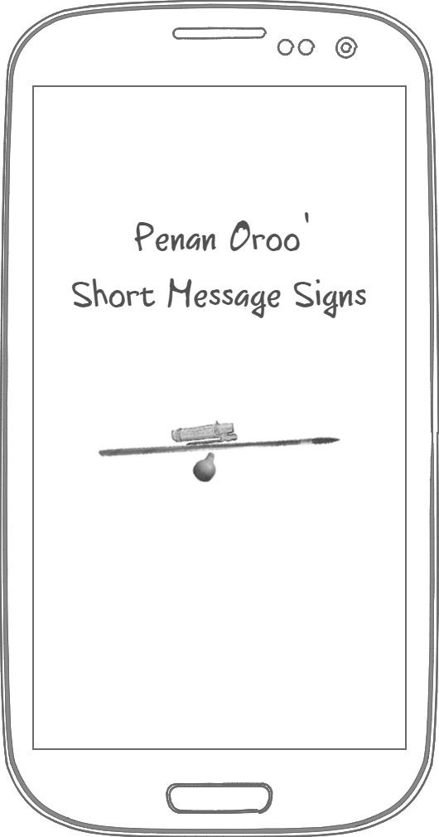
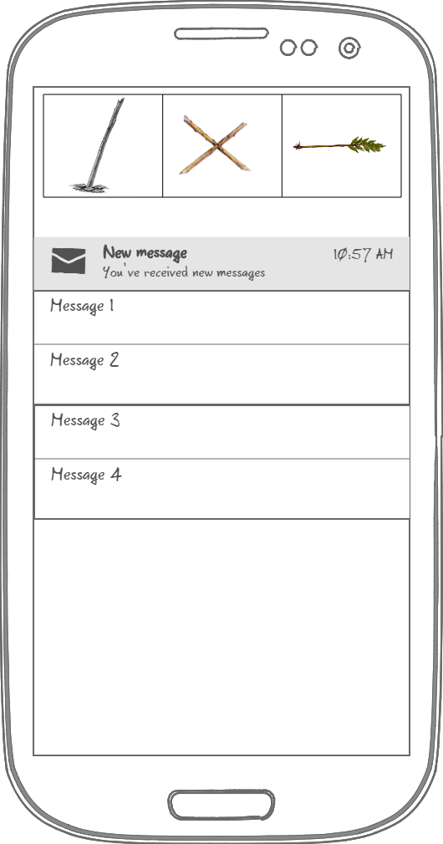
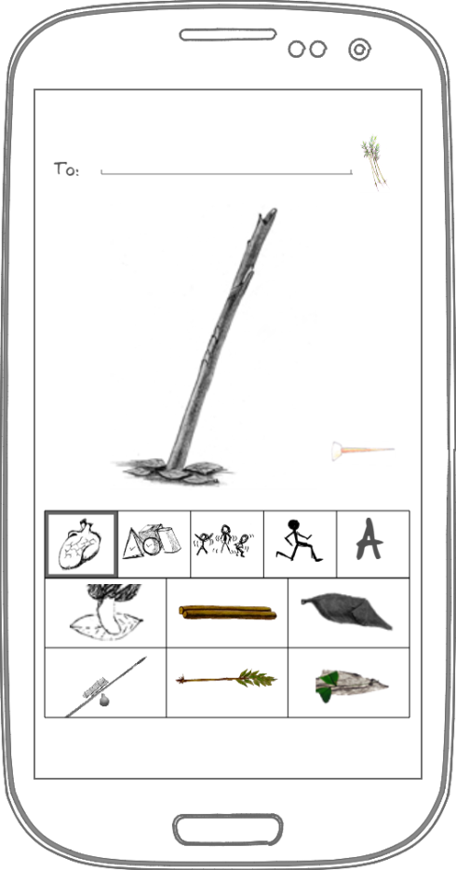
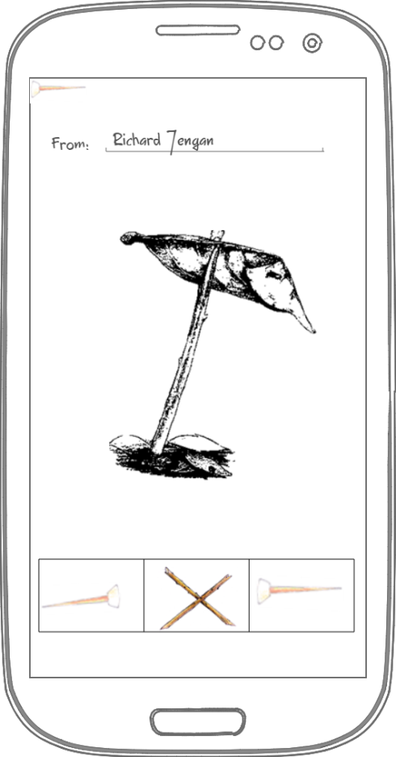
PO-SMS: App Screen Layout Design
Penan’s Oroo’Short Message Signs (PO-SMS): co-design of a digital jungle sign language application,
T Zaman, H Winschiers-Theophilus, IFIP Conference on Human-Computer Interaction, 489-504, 2015

Slide 15
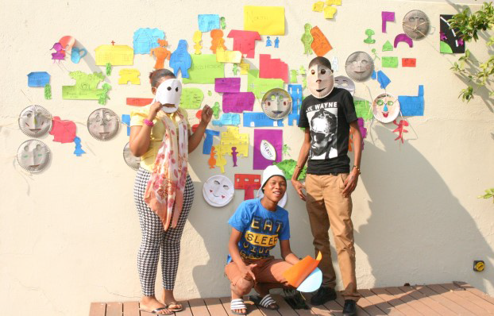
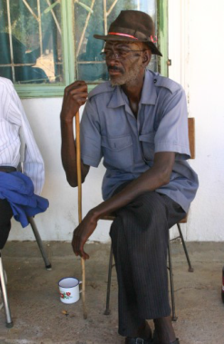
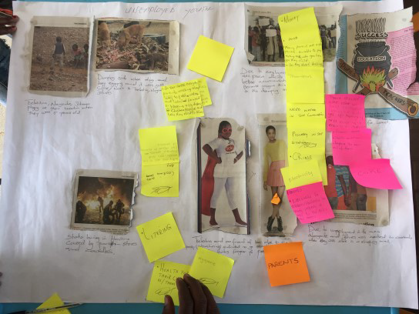
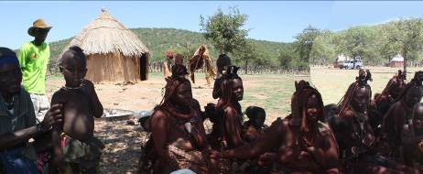
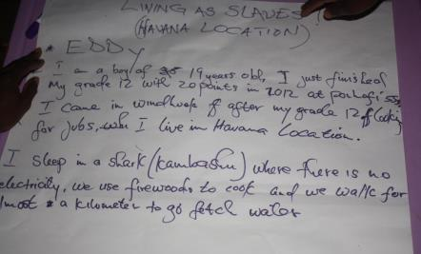
User-created Personas in Namibia
Havana youth
Highly contextualised
Stereotypical self-description
Realistic, no details
but interlinked stories
OvaHimba – collective personas
Rural Elders
Not universal in description
not valid across cultures
DG Cabrero, H Winschiers-Theophilus, J Abdelnour-Nocera (2016) A Critique of Personas as representations of" the other" in Cross-Cultural Technology Design, in Proceedings of the First African Conference on Human Computer Interaction, Kenya

Slide 16
Conclusion
Personas are an effective design tool
Personas are easy to create and use
Personas are not always well understood

